Slide 1
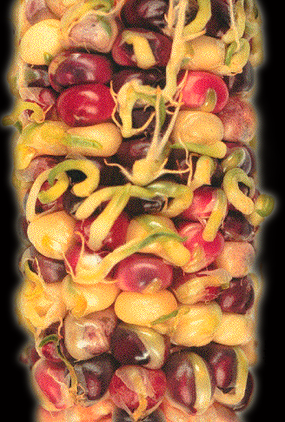
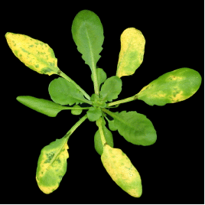
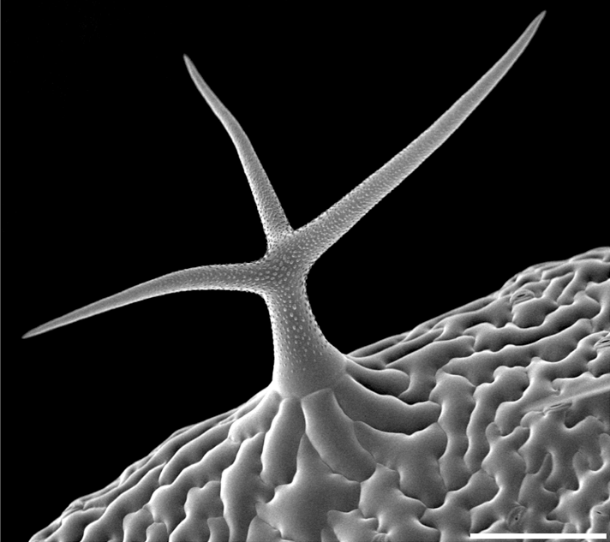
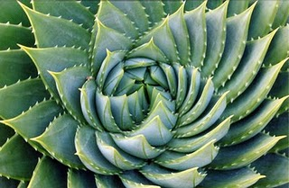
Small molecule hormones link the environment to development
O
O
H
brassinolide
O
H
O
H
O
O
C
H
3
O
H
H
O
H
H
H
O
H
H
H
O
H
O
O
jasmonic acid
O
abscisic acid
H
H
O
H
C
C
H
H
O
ethylene
H
N
O
H
N
O
H
H
N
N
auxin
O
H
O
O
H
N
N
H
H
H
O
O
cytokinin
gibberellin
Credit Yvon Jaillais
“Fibonacci” - Aloe

